Slide 1
Statistical Programming in R
Srinivasa, Siddesh, Shetty & Sowmya

Slide 2
6: Functions in R
Learning Objectives
Scope and environment of functions, nested functions, mathematical, and cumulative functions
Applications of functions—quicksort, binary search trees, recursion
Loading an R package
Calculus in R
Input and output operations

Slide 3
6.1: Introduction
A function is a block or chunk of code having a specific structure, which is often singular or atomic in nature and can be reused to accomplish a specific task.
Functions serve as tools to repeatedly execute certain complex instructions coupled together, since they are self-contained
A function has:
an input(in the form of arguments)
a task (set of statements or lines of code)
an output (a return value).
A function is known by many names in various programming languages such as methods, procedures, and sub-routines.

Slide 4
6.2: Writing a Function in R
The structure of a function in R is similar to that of most of other programming languages which looks something like this:
function_name <- function(arguments)
{
computations on the arguments
task-specific code statements
}

Slide 5
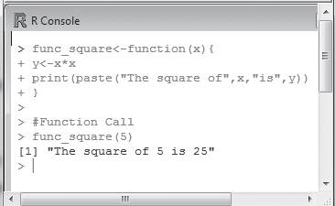
Figure 6.1 illustrates a simple example to create a user-defined function to compute the square of an integer in R.
Fig. 6.1 User-defined function in R

Slide 6
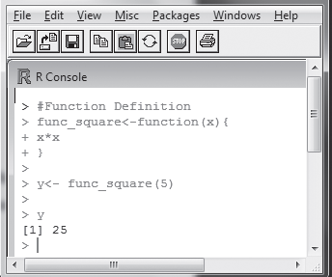
The method shown in Fig. 6.2 does not make use of the ‘return’ keyword explicitly.
Fig. 6.2 Returning value from function in R

Slide 7
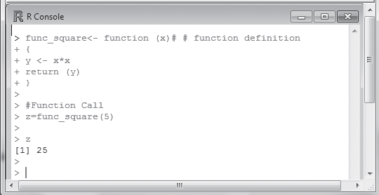
In Fig. 6.3, the return keyword is used and the returned value is stored in a variable using the = sign.
Fig. 6.3 Returning the value using return keyword

Slide 8
6.3: Nested Functions
R allows defining a function inside a function, which is commonly known as nesting of functions. Function nesting can be achieved by defining one function inside another, or by calling one function from another.
For example,
first_func <- function (arguments1)
{
computational code on arguments of first_func
task-specific statements
second_func <- function (arguments2)
{
computational code on arguments of second_func
task-specific statements
return statement 2 (if any)
}
rest of function body
return statement 1 (if any)
}

Slide 9
The same effect as that of the aforementioned code can be achieved in the following manner:
second_func <- function (arguments2)
{
computational code on arguments of second_func
task-specific statements
return statement 2 (if any)
}
first_func <- function (arguments1)
{
computational code on arguments of first_func
task-specific statements
my_value <- second_func (arguments2)
rest of function body
return statement 1 (if any)
}

Slide 10
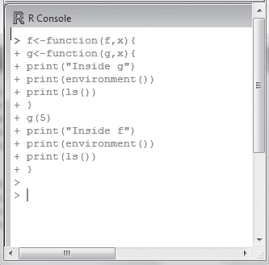
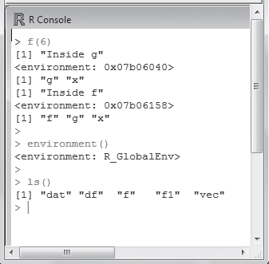
6.4 Function Scoping
The notion of environment and scope is impor
Function Environment
The first thing that gets created when the R interpretation begins is its environment. All variables defined in the R script are the part of this environment and are listed as environment variables as shown in Fig.

Slide 11
Function Scope
Scoping is the set of rules that governs how R looks up the value of a symbol
Global variables are those that are available throughout the program changes are reflected in all further references to that variable
A variable defined in a function is not accessible outside the function. It is released when the function ends.

Slide 12
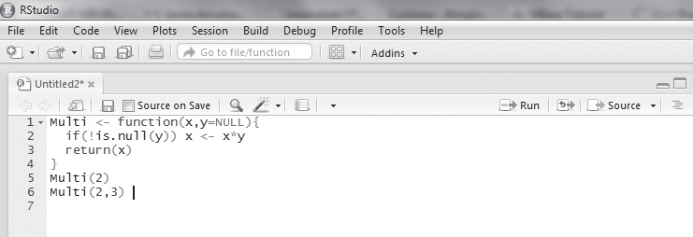
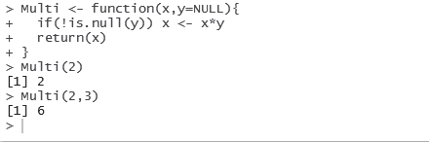
Default Values for Arguments
the concept of a default value is legal
The default argument value can be passed only once
The value of the default argument needs to be declared while declaring the function.
Example 6.2 Write a program to multiply two numbers using a function with a default value. Assuming default value as NULL.

Slide 13
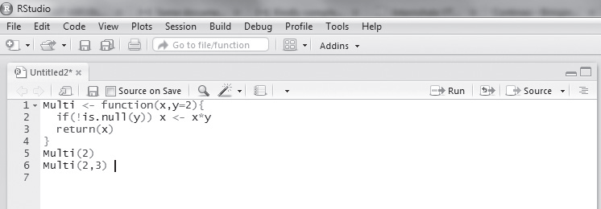
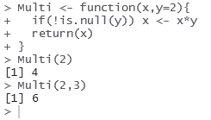
Figure 6.8 shows a code construct where the default value y is passed as 2 instead of NULL.
Fig. 6.8 Function with a non-NULL default value

Slide 14
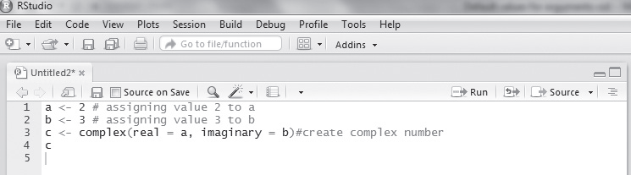

Returning Complex Objects
Complex functions are incorporated in base package of R language. To generate a complex number, a + ib, a call is made to the complex function in R. Example 6.3 shows the creation of a complex number.
Example 6.3 Demonstrating the creation of a complex number.

Slide 15
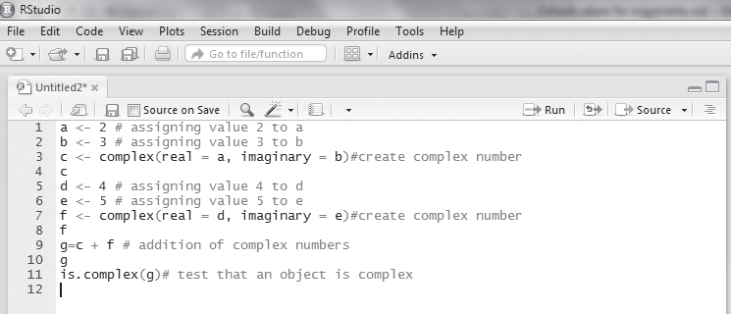
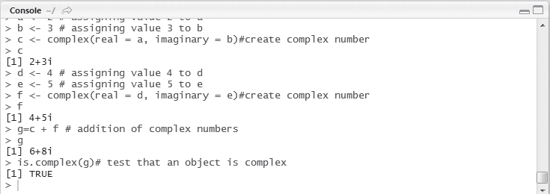
Example 6.4 Add two complex numbers using the complex function and test whether the sum of the complex numbers is complex or not.

Slide 16
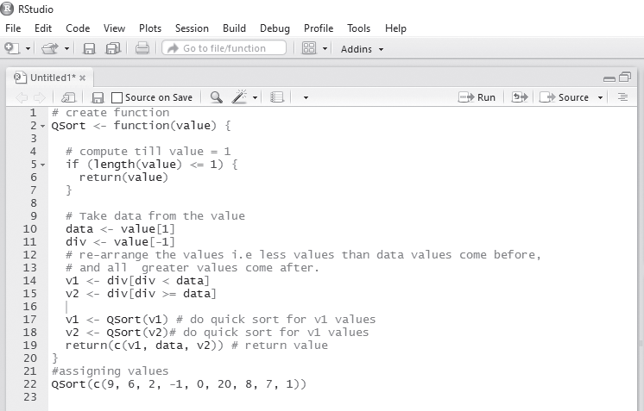
Illustration of Quicksort

Slide 17
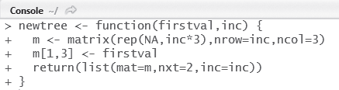
Binary Search Trees
A binary search tree is a data structure where the left child of the root is lesser than the right child of the root.
In order to create the binary search tree in R, the following program is used.
Function 1: To create a new tree

Slide 18
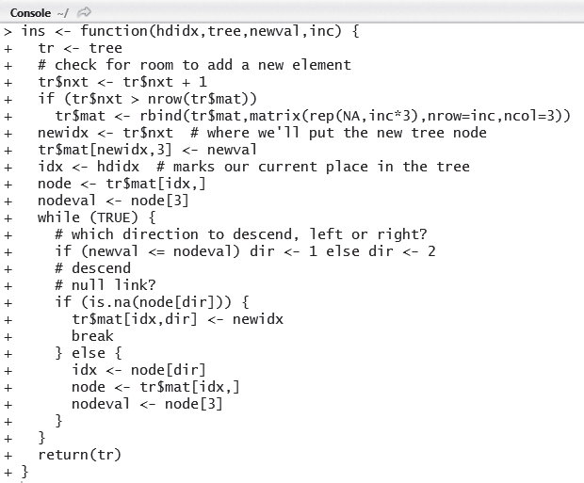
Function 2: To insert the values into the tree such that it has the properties of the binary search tree

Slide 19
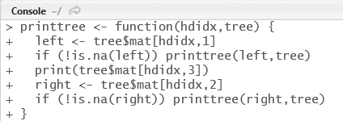
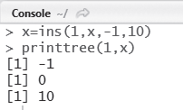
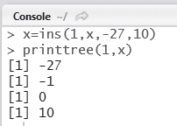
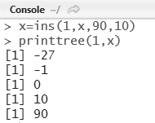
Function 3: To print the values in sorted order using in-order traversal In order to print the values of the tree in in-order

Slide 20
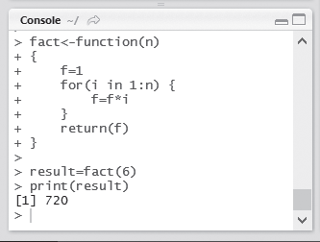
6.5 Recursion
Recursion is a technique where a function calls itself. The concept of recursion is most used when a large problem needs to be broken down into simpler sub-problems in order to simplify the complexity of computation.
The factorial of a number n is denoted by n! and is defined as
n! = n x n x (n – 1) x (n – 2) x … x 2 x 1
Following this definition, 6! = 6 x 5 x 4 x 3 x 2 x 1 = 720

Slide 21
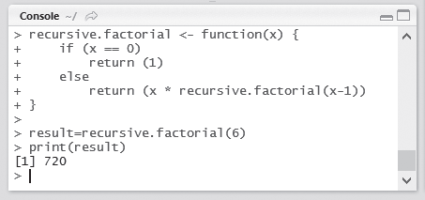
Example 6.5 Write a program to calculate factorial of a number using recursive computation.

Slide 22
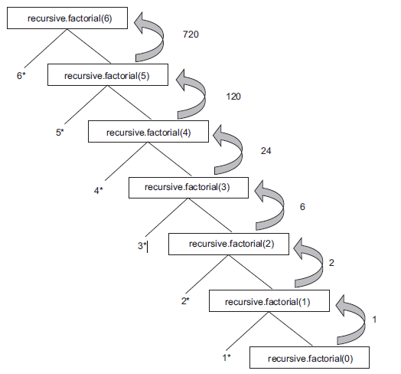
Recursion tree

Slide 23
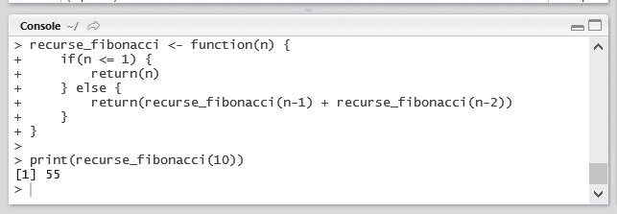
Example 6.7 Write a program to find nth Fibonacci number using recursive computation.
Fig. 6.23 Recursive computation nth Fibonacci number

Slide 24
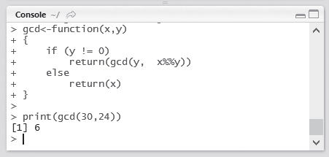
Example 6.8 Write a program to calculate the GCD of two numbers using recursive computation.
Fig. 6.24 Recursive computation of GCD of two numbers

Slide 25
6.6 Loading an R Package
R comes with numerous packages that are made available to install R onto the computer.
packages need to be first loaded into the workspace
library(package_name)
To unload a package from the workspace, the following statement is used
detach(package: package_name)
Methods of Loading
Loading a package is fairly simple in R. This can be done using the following statement:
install.packages(“package_name”)
Example:
install.packages(“ggplot”)
following two commands are used to include the packages:
install.packages(“ggplot2”, lib=”/data/Rpackages/”)
library(ggplot2, lib.loc=”/data/Rpackages/”)

Slide 26

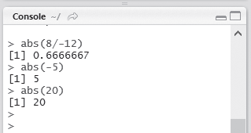
6.7 Mathematical Functions in R
R provides a large number of mathematical and statistical functions to perform easy calculations.
abs(numeric) This function takes in a numeric value and returns the absolute value of the input. This operation is equivalent to finding the mod of a number.
Fig. 6.25 Absolute value

Slide 27
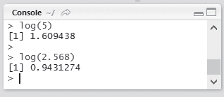
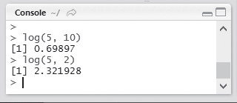
log(numeric) This function returns the natural logarithm (to base e) of a numeric value as shown in Fig. 6.26
The log function also allows us to provide an optional argument, which explicitly change the base from e to any other base, as shown in Fig. 6.27
Fig. 6.26 Logarithm
Fig. 6.27 Logarithm to variable base

Slide 28
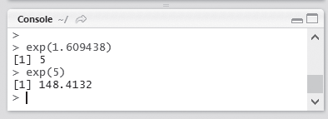
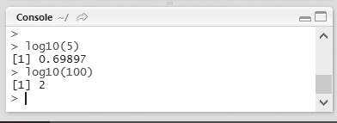
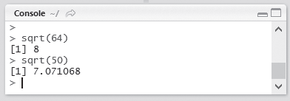
exp(numeric) This function is the inverse of the log function, or the antilog. The output is calculated at e raised to the power of the numeric value (refer to Fig. 6.28).
log10(numeric) This function returns the logarithm of the numeric value but with base 10.
sqrt(numeric) This function calculates the positive square root of the given numeric value.
Fig. 6.28 Antilog
Fig. 6.29 Logarithm to base 10
Fig. 6.30 Square root

Slide 29
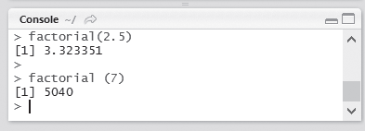
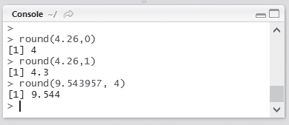
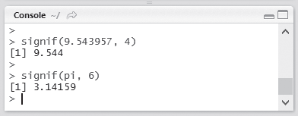
factorial(numeric) This function returns the factorial of a number.
round (numeric, digit) This function takes in two arguments—a numeric and the precision (digits).
signif(numeric, digit) This function takes in two arguments again—a numeric value and the precision argument.
Fig. 6.31 Factorial
Fig. 6.32 Rounding off
Fig. 6.33 Significant digits

Slide 30
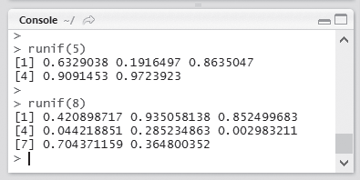
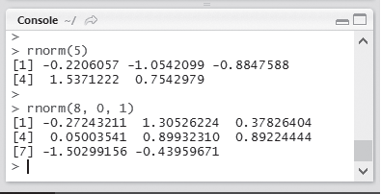
runif(numeric) This produces numeric number of uniform random numbers between 0 and 1.
rnorm(numeric) This produces numeric number of random numbers from a normal distribution.
Fig. 6.34 Random number generator
Fig. 6.35 Random number generator from normal distribution

Slide 31
6.8 Cumulative Sums and Products
The cumulative functions in R provide a way of progressively calculating the sum or product of a sequence
cumsum(x)
cumprod(x)
Two interesting observations can be noted in the case of cumulative functions:
1. If the supplied object is a matrix, cumprod() using the column major approach to convert x into a vector.
2. If a data frame is sent as an argument, the function is applied only to each row.

Slide 32
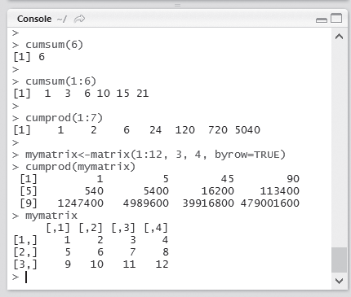
Fig. 6.37 Cumulative functions

Slide 33

6.9 Calculus in R
R has calculus capabilities for calculating derivative expressions and numerical integration
Figure 6.38 demonstrates the use of the D() function in R to calculate the derivative of a simple function in R.
Fig. 6.38 Derivative calculation

Slide 34
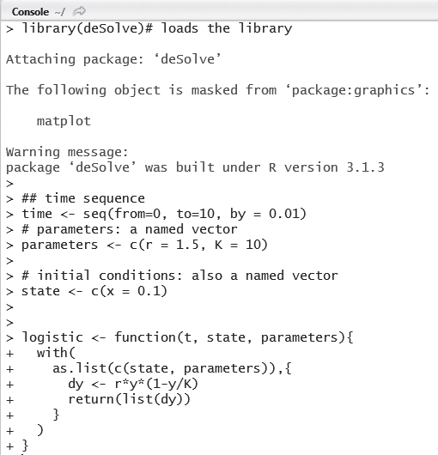
Fig. 6.39 Use of deSolve package

Slide 35
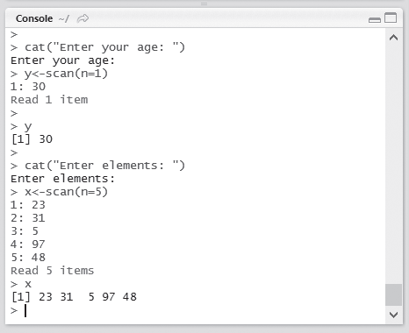
Using scan() Function
Fig. 6.42 Using scan() function

Slide 36
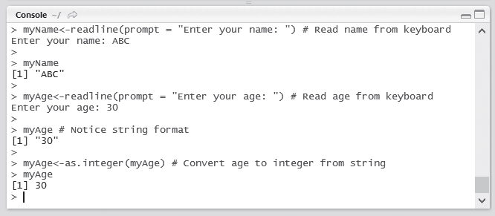
6.10 Input and Output Operations
Using readline() Function
readline (prompt = “ ”)
Fig. 6.41 Using readline() function

Slide 37
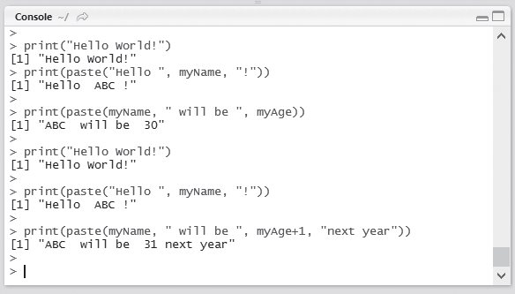
Displaying Output and Results
Function that can be used to produce output is the print() function, which is similar to the I/O function in most other programming languages.
Fig. 6.43 Displaying results using print() function

Slide 38
END

